Slide 1

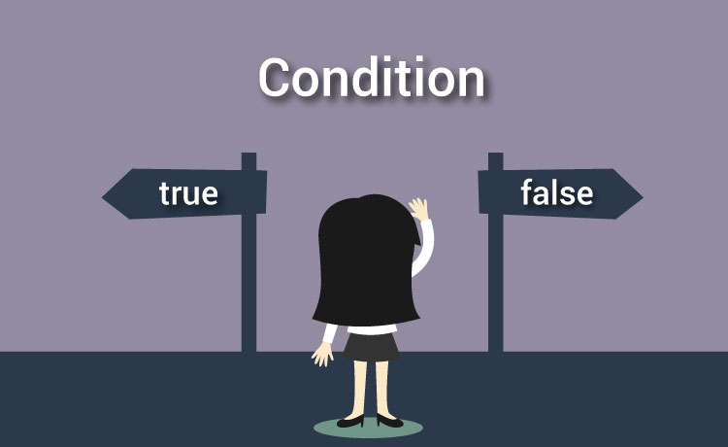
Nested Loops and Conditions
Chapter 05
“Learning programming is more like a loop than a constant, talent is generated by an iterative process rather than a constant declared at the beginning of the process”

Slide 2

Today
Check In
If you are below a B currently look at the office hours available to meet with the learning assistants Kyle and Alizah and my office hours.
Quiz 2 March 5/6
GE01 will be posted Friday and will be due March 15th/16th
Attend other section if you need - just let me know
CS1050 003 MW 4-5:50PM AES 220
CS1050 004 TTh 12-1:50PM EAS 220
You need a C in this class
As the prerequisite for CS2
Goals
Iterative Control Structures
Nested Control Structures
CS Community Circle Event Click to RSVP

Slide 3
User Story and Acceptance Criteria
Create test cases
User Story: As a user, I want to enter my username and password, So that I can log in to the system securely.
❌ Scenario 3: Incorrect Password
Given the user enters the correct username but an incorrect password, When the system checks the credentials, Then the system displays "Incorrect password. Try again." And prompts the user to re-enter the credentials.
✅ Scenario 1: Successful Login
Given the user enters the correct username and password, When both credentials match the stored values, Then the system displays "Login successful! Welcome." And the user is granted access.
🔁 Scenario 4: Repeated Attempts
Given the user enters incorrect credentials, When they continue entering invalid usernames or passwords, Then the system should keep prompting the user Until the correct username and password are provided.
❌ Scenario 2: Incorrect Username
Given the user enters an incorrect username, When the system checks the credentials, Then the system displays "Incorrect username. Try again." And prompts the user to re-enter the credentials.

Slide 4
Create Test Cases and Design the Algorithm
Think about all the different scenarios and create a precondition and postcondition. I usually start with what can go wrong.
Correct Login:
Username: Test
Password: p@$$
Precondition | Post Condition | Notes
Username: d Password: p@$$ | Incorrect username. Try again. | If user name incorrect repeat and ask to reenter
Username: test Password: P@$$ | Incorrect password. Try again. | If username correct If password incorrect repeat and ask to reenter
Username: test Password: p@$$ | Login successful! Welcome. | Correct do not repeat - exit loop
Enter incorrect first Username: tes Password: pass Then correct Username: test Password: p@$$ | Incorrect password. Try again. Login successful! Welcome. | If username correct If password incorrect repeat and ask to reenter Correct do not repeat - exit loop
Precondition | Post Condition | Notes for algorithm
Username: d Password: p@$$ | Incorrect username. Try again. | If user name incorrect repeat and ask to reenter
Username: test Password: P@$$W0RD | Incorrect password. Try again. | If username correct If password incorrect repeat and ask to reenter
Username: test Password: p@$$w0rd | Login successful! Welcome. | Correct do not repeat - exit loop
Enter incorrect first Username: tes Password: pass Then correct Username: test Password: p@$$w0rd | Incorrect password. Try again. Login successful! Welcome. | If username correct If password incorrect repeat and ask to reenter Correct do not repeat - exit loop

Slide 5
Create Test Cases and Design the Algorithm
Think about all the different scenarios and create a precondition and postcondition. I usually start with what can go wrong.
Correct Login:
Username: Test
Password: p@$$
Precondition | Post Condition | Notes
Username: d Password: p@$$ | Incorrect username. Try again. | If user name incorrect repeat and ask to reenter
Username: test Password: P@$$ | Incorrect password. Try again. | If username correct If password incorrect repeat and ask to reenter
Username: test Password: p@$$ | Login successful! Welcome. | Correct do not repeat - exit loop
Enter incorrect first Username: tes Password: pass Then correct Username: test Password: p@$$ | Incorrect password. Try again. Login successful! Welcome. | If username correct If password incorrect repeat and ask to reenter Correct do not repeat - exit loop
Precondition | Post Condition | Notes for algorithm
Username: d Password: p@$$ | Incorrect username. Try again. | If user name incorrect repeat and ask to reenter
Username: test Password: P@$$W0RD | Incorrect password. Try again. | If username correct If password incorrect repeat and ask to reenter
Username: test Password: p@$$w0rd | Login successful! Welcome. | Correct do not repeat - exit loop
Enter incorrect first Username: tes Password: pass Then correct Username: test Password: p@$$w0rd | Incorrect password. Try again. Login successful! Welcome. | If username correct If password incorrect repeat and ask to reenter Correct do not repeat - exit loop
Next develop algorithm
Write in pseudocode
1. Focus on type of algorithm for condition.
2. After algorithm works to branch then then work on loop

Slide 6
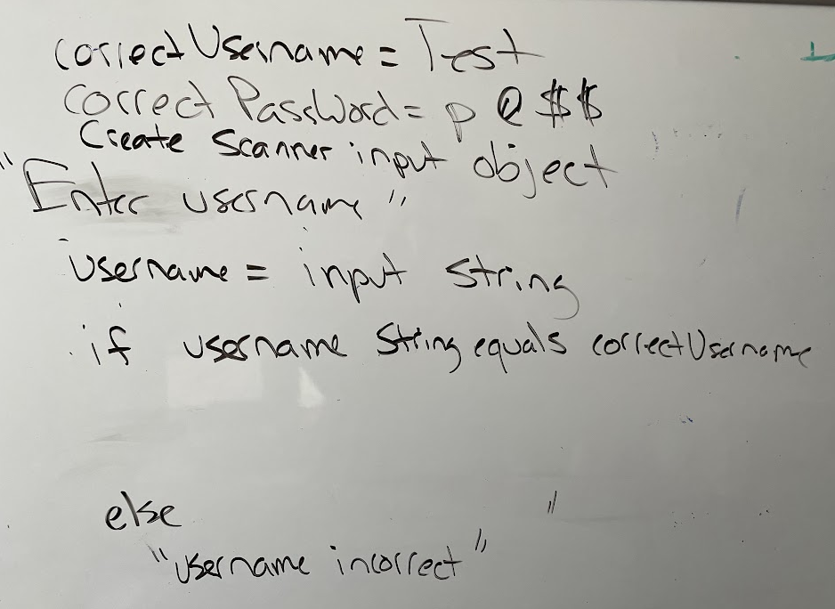
Check if username correct
Precondition | Post Condition | Notes for algorithm
Username: d Password: p@$$ | Incorrect username. Try again. | If user name incorrect repeat and ask to reenter
Ask and store username
If the username is correct continue to check password
else display incorrect username

Slide 7
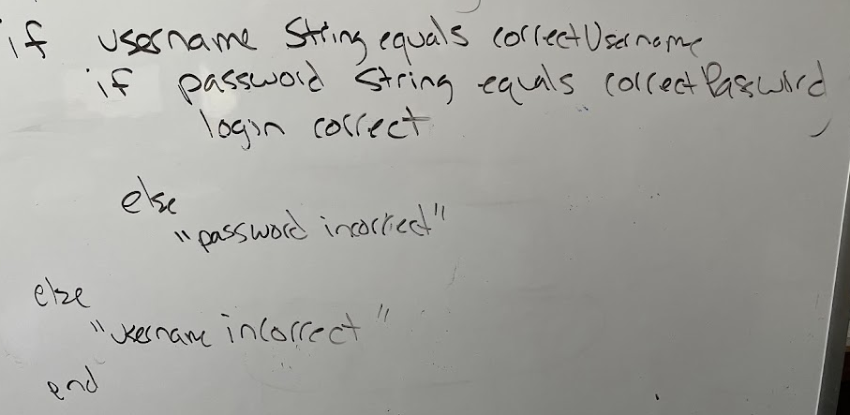
If username correct check if password correct
Precondition | Post Condition | Notes
Username: test Password: P@$$ | Incorrect password. Try again. | If username correct If password incorrect repeat and ask to reenter
Username: test Password: p@$$ | Login successful! Welcome. | Correct do not repeat - exit loop
Nested if
If username correct
If the password is correct
Display Login correct
else display incorrect password

Slide 8
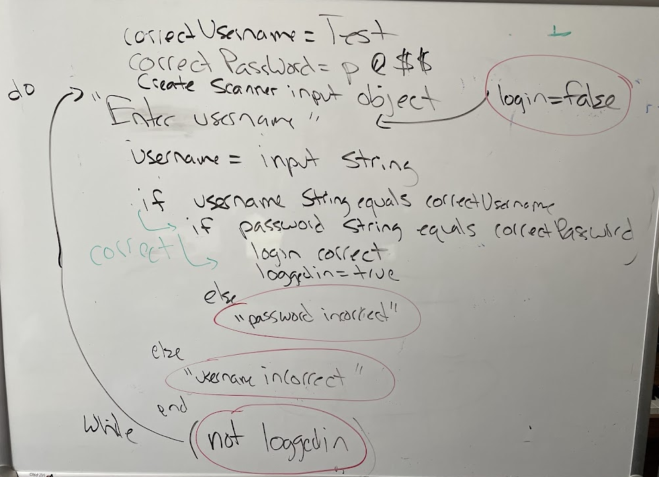
Repeat until correct
Precondition | Post Condition | Notes
Enter incorrect first Username: tes Password: pass Then correct Username: test Password: p@$$ | Incorrect password. Try again. Login successful! Welcome. | If username correct If password incorrect repeat and ask to reenter Correct do not repeat - exit loop
Do repeat to get username and password
Start with login false before do while loop using boolean flag variable
Set login boolean flag to true when both username and password are correct
While not logged in keep repeating - check boolean flag
Exit when login true

Slide 9
Review Nested If
Placing if-statements inside if-statements
// Extract the first and second character
char degreeFirstChar = degree.charAt(0);
char degreeSecondChar = degree.charAt(1);
// If level is valid prompt for ticket package
if (degreeFirstChar == 'B')
{
if ((degreeSecondChar == 'A') || (degreeSecondChar == 'S') || (degreeSecondChar == 'I'))
{
// Check which level to display information
}
else //invalid second char for degree
{
System.out.println("Invalid degree");
}
}
else //invalid first char for degree
{
System.out.println("Invalid degree");
}
If (boolean expression)
{
if(boolean expression)
{
statement;
statement;
statement;
} // end of inner if
} // end of outer if

Slide 10
Nested For Loop
For loop within a for loop. Code you were assigned to explore from last lecture: Nested for loops Example
for (int outer = 1; outer < 3; outer++)
{
System.out.println ("The outer loop iteration is = " + outer);
// This is the inner for loop
// It will do all iterations before outer loop does another iteration
for (int inner = 1; inner <= 5; inner++)
{
System.out.println (" The inner loop iteration is = " + inner);
}
}
You can put while loops in for loops or for loops in while loops.
Loops can be in if/else conditions and if/else conditions can be in loops.

Slide 11
Nested For Loop
For loop within a for loop. Code you were assigned to explore from last lecture: Nested for loops Example
for (int outer = 1; outer < 3; outer++)
{
System.out.println ("The outer loop iteration is = " + outer);
// This is the inner for loop
// It will do all iterations before outer loop does another iteration
for (int inner = 1; inner <= 5; inner++)
{
System.out.println (" The inner loop iteration is = " + inner);
}
}
The outer loop iteration is = 1
The inner loop iteration is = 1
The inner loop iteration is = 2
The inner loop iteration is = 3
The inner loop iteration is = 4
The inner loop iteration is = 5
The outer loop iteration is = 2
The inner loop iteration is = 1
The inner loop iteration is = 2
The inner loop iteration is = 3
The inner loop iteration is = 4
The inner loop iteration is = 5
You can put while loops in for loops or for loops in while loops.
Loops can be in if/else conditions and if/else conditions can be in loops.

Slide 12
Nested While Loop
int outer = 1;
while (outer < 3) {
System.out.println ("The outer loop iteration is = " + outer);
// This is the inner while loop
// It will do all iterations before outer loop does another iteration
int inner = 1;
while (inner <= 5) {
System.out.println (" The inner loop iteration is = " + inner);
inner++;
}
outer++;
}
Displays
The outer loop iteration is = 1
The inner loop iteration is = 1
The inner loop iteration is = 2
The inner loop iteration is = 3
The inner loop iteration is = 4
The inner loop iteration is = 5
The outer loop iteration is = 2
The inner loop iteration is = 1
The inner loop iteration is = 2
The inner loop iteration is = 3
The inner loop iteration is = 4
The inner loop iteration is = 5
You can place any type of loop inside another loop

Slide 13
Reminder: 🚫 System.Exit Break and Continue
Break in Loops
Use a "break" in switch statements to end a case
Don't use break, continue exit, or return inside a loop or if/else in this class!
Continue in Loops
Don't use continue inside a loop in this class!
Note
There are cases when the use of a break or continue in a loop is necessary
Overusing or improper use can make a program hard to read, maintain, and debug.
Best practice is to never use these unless you have a specific situation.
IN THIS CLASS, WE WILL NOT HAVE A SITUATION THAT REQUIRES THIS type of exiting a control structure

Slide 14
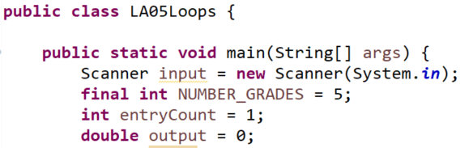
🚫 Do Not Create Variables In Class and Outside of Main
Do not use global variables.
public class LA05 {
public final static int GRADES_LIMIT = 5;
public static double grade = 0;
public static double temp = 0;
public static void main(String[] args) {
Until we go over declaring variables and constants this way only declare your variables and constants in main.
Global constant
Global variables

Slide 15
Quiz Review Module 2
Open you technical document Can you find information on the following
Implement methods from the Character and Math classes
Use String and Scanner class
Create an object variable from the Scanner class to use methods to read input from the keyboard for these data types: double, integer, char, String
Write conditions to make decisions using if/else:
Relational operators
Scope when declaring variable in if { } or in main {}
Logical Operators
Nested if
Multi-way if
Using switch statement to branch
How are switch statements different from if(condition)

Slide 16

Coding Mindset and Quality Code
For this class we are learning to write structured code and will not be using break, continue, return or exit in any loop. It can make the code difficult to understand, maintain and debug.
Do not create infinite loops.
There can be special circumstances for performance but this class we will be focusing on quality code and not performance.
while (true) {
If (test for condition here instead of in while loop) {
// do processing
}
else {
break;
}
}
Do not use break, continue, return or exit in any loop. You should use the while loop condition to test when the loop should no longer execute..

Slide 17
Preparation GE03
Create java source file called M03L11LoopsConditions. Add comments to the code.
2.1.1. Write a test case to find the sum of the numbers 1 to 5.
2.1.2 Write code to sum the numbers from 1 to a max using a for loop.
2.1.3 Write code to sum the numbers from 1 to max using a while loop.
2.1.4 Write code to sum the odd numbers from 1 to max.
2.1.5 Write code to ask the user to enter an age. If the age is not greater than 0 repeat the question until a valid age value is entered.

Slide 18
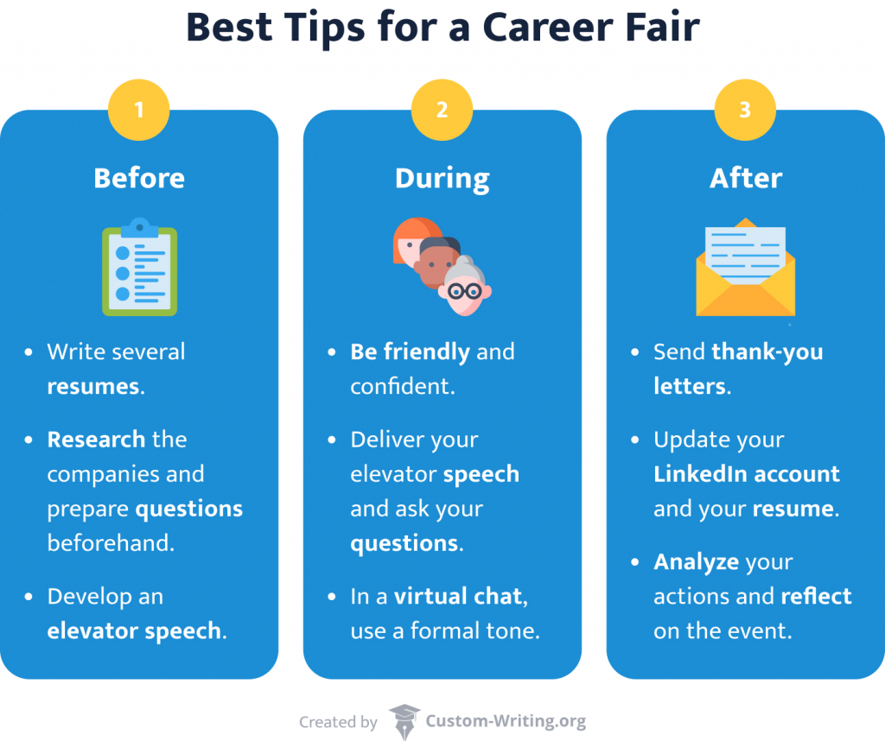
Career Fair
Spring Job & Internship Fair 2025
The Spring Job & Internship Fair is open to all Auraria Campus students/alumni from all majors who are looking for post-graduate opportunities or internships in a wide variety of industries.
Go check it out! Start learning more about internship and career opportunities.
Matthew Demerson (mademerson@msudenver.edu) manages Industry Partnerships in Electronics, Technology and Information and is located in the Administration Building, Suite 270B
Career Preparation - Drafting a resume

Slide 19
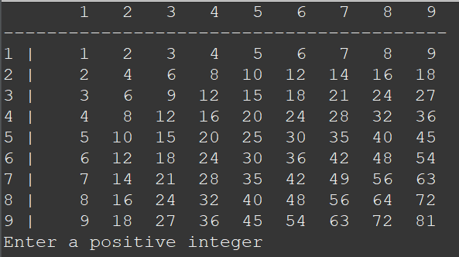
Output

